Slide 1
Office 365 development
Speaker name

Slide 2
Deep dive into Azure AD with the Microsoft Graph

Slide 3
Agenda
Introduction
OAuth basics and authentication flow
App registration tool
Azure Management Portal access
Troubleshooting

Slide 4
Developer vision

Slide 5
1
Introduction

Slide 6
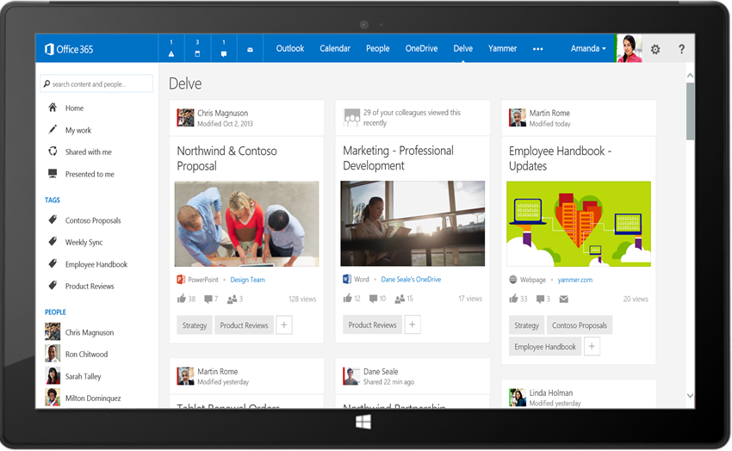
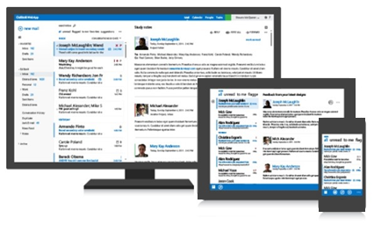




Microsoft Graph API
Your App
https://graph.microsoft.com/
USERS
GROUPS
FILES
MAIL
CALENDAR
TASKS
Insights and relationships from Office Graph

Slide 7
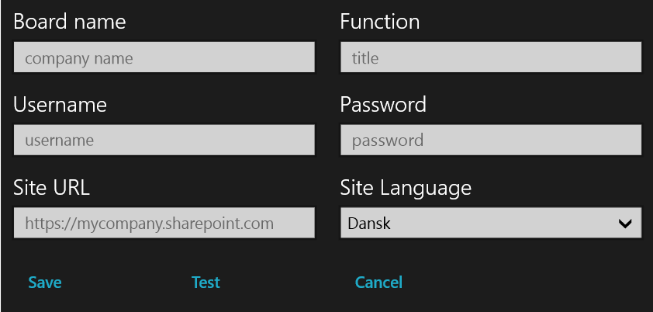
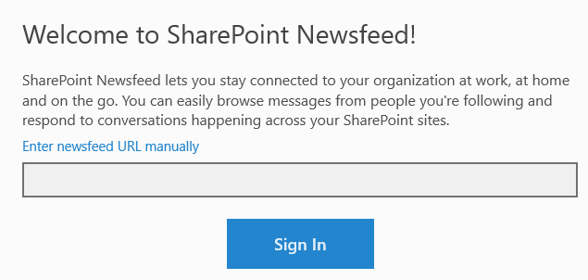
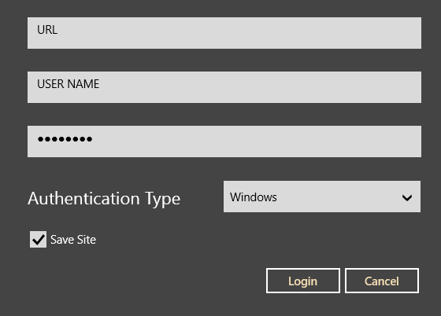
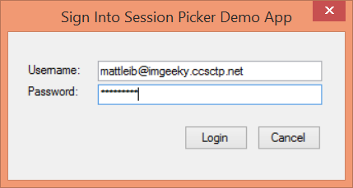
Office 365 device apps
Notes:
Prior to the release of the Office 365 APIs, device apps had to prompt users for credentials for the service, and in some cases the location of the resources.
Storing credentials is very risky, and a worst practice.

Slide 8
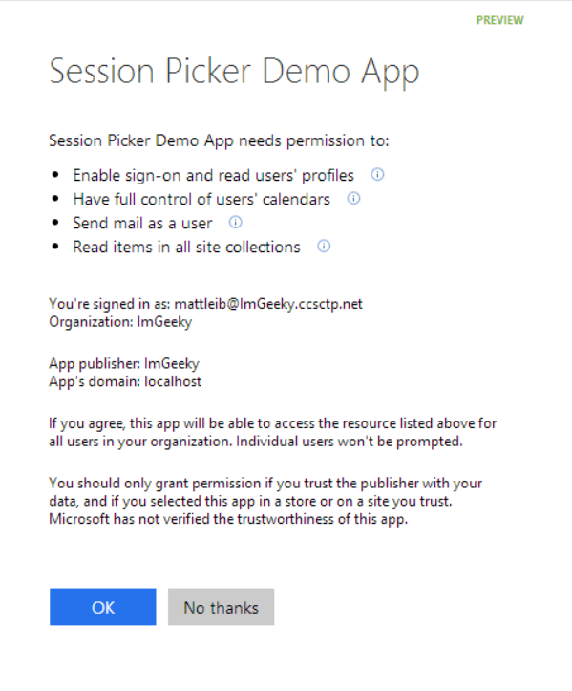
Azure AD OAuth in Office 365
Single auth flow for Office 365
Azure AD Graph, Exchange, SharePoint
Device apps and web sites
Admin and end-user consent
Secure protocol
OAuth 2.0
No capturing user credentials
Fine-grained access scopes
Supports MFA and federated user sign-in
Long-term access through refresh tokens
Notes:
With the Office 365 APIs, which leverage the Azure AD Oauth service, device apps no longer need to store user credentials.
Azure AD has implemented a “Common Consent” dialog, providing a consistent interface for permission grants.
Typically, OAuth is used to access a single resource. Common Consent is unique in that it can provide a token to Exchange Mail/Calendar/Contacts as well as SharePoint lists and files in OneDrive .

Slide 9
2
OAuth basics and authentication flow

Slide 10
Authentication to Microsoft Graph using resource ID
NATIVE APPLICATION
AZURE AD AUTHORIZATION ENDPOINT
AZURE AD TOKEN
ENDPOINT
MICROSOFT GRAPH API
Request authorization code
Sign-in via browser pop-up
Return authorization code
Redeem authorization code and acquire access token for Office 365 resource
Return access token and refresh token
Call Office 365 API using the access token
Return Http response
Notes:
** This slide has animations **
To facilitate the issuance of tokens for multiple resources, a different approach is required.
Instead of requesting an access token from the Authorization Endpoint, an authorization code is requested. The Resource Id for which a token is desired in included in the call to the Authorization Endpoint. The Authorization Endpoint will ensure the user is logged in, and will present the Common Consent dialog that lists the permissions requested by the application.
The authorization code is redeemed at the new Token Endpoint, which returns an access token and a refresh token. The token is issued for the resource identified in the authorization code request.
The access token is used to access the resource. The access token represents the user’s permissions to the resource. The application permission is granted during common consent.

Slide 11
Authentication Options
Azure AD only
Separate auth flow supports Azure AD accounts only
Azure AD and Microsoft Accounts (Preview)
Converged auth flow supports Azure AD accounts and Microsoft accounts (LiveID - hotmail.com, etc.)

Slide 12
Microsoft Account + Azure AD
Many apps want to sign users in from both Microsoft account and Azure AD
Now in preview:
Single endpoint, OpenID Connect and OAuth 2.0
Single SDK
Single end user sign in experience
Single app registration experience
Works with Microsoft Graph
Single API endpoint, business and consumer data

Slide 13
Libraries: http://github.com/AzureAD
Client: Active Directory Authentication Library (ADAL)
.Net, Windows Store, Windows Phone
JavaScript
iOS
Android
Xamarin
Cordova
Node.js
Java
Server
.Net: ASP.Net OWIN middleware for OpenID Connect and OAuth 2.0
Node.js
More to come

Slide 14
OAuth authentication flow
2 OAuth basics and authentication flow
Demo
Notes:
Using the browser and Fiddler, the authentication and token issuance flow can be demonstrated without writing code. Exercise 2 in the lab has detailed steps. (Exercise 1 is a pre-requisite.)

Slide 15
3
App registration tool

Slide 16
App registration options
App registration is stored in Azure AD
Simplified registration experience
http://graph.microsoft.io/app-registration
Two models for registration
App model v1
App model v2 (preview)

Slide 17
App registration options
Azure AD “app model v1“
Separate authentication flow
Supports Azure AD accounts only
Office 365 app registration tool
http://dev.office.com/app-registration

Slide 18
App registration options
Azure AD "app model v2" (preview)
Converged authentication flow
Supports Azure AD accounts and Microsoft accounts (LiveID—hotmail.com, etc.)
New app registration portal
http://apps.dev.microsoft.com/

Slide 19
http://graph.microsoft.io/app-registration
3 App registration tool
Demo

Slide 20
4
Azure Management Portal access

Slide 21
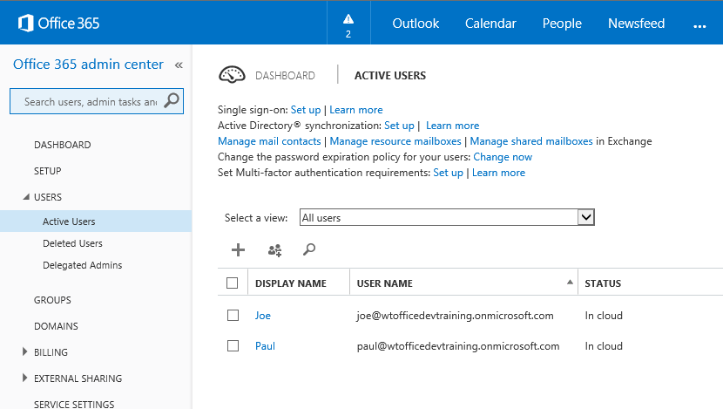
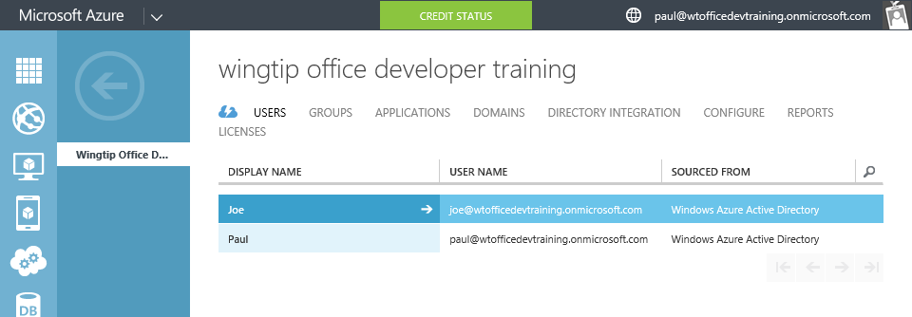
Azure Active Directory (Azure AD)
Included in Office 365 subscription
Users and groups managed in Office 365 portal
Changes persisted in Azure AD
Notes:
Although an Azure AD is included with Office 365, accessing it via the Azure Management Portal requires a “sign-up.” However, there are no charges from Azure for using AD. (Charges will occur if other services are used.)

Slide 22
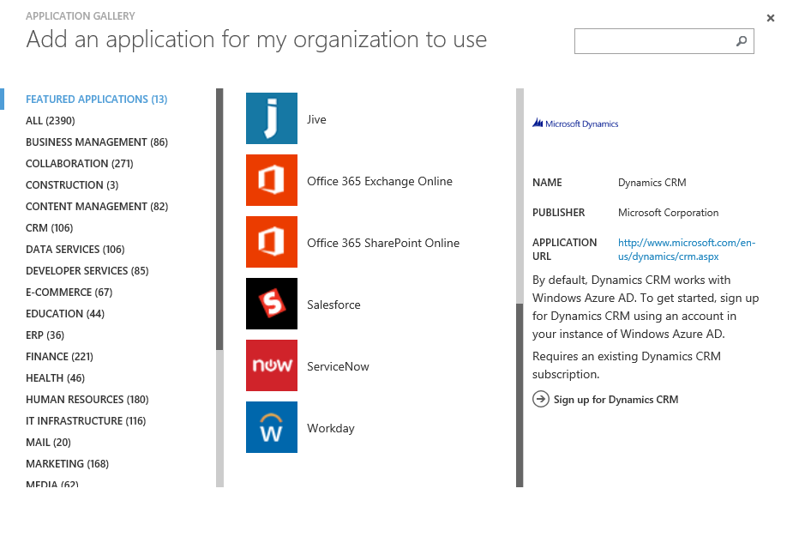
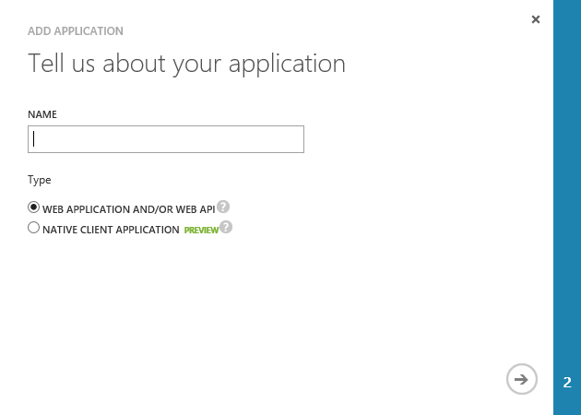
Application registration
Application types
Custom developed
Third party, published in the gallery
Office 365 SharePoint, Exchange
Dynamics CRM
Thousands of others
Custom applications
Web application and/or WebAPI
Native client

Slide 23
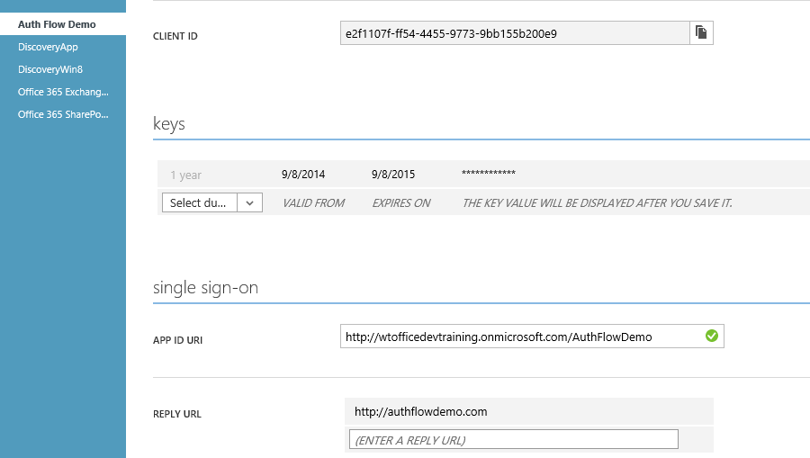
Custom application registration
Key information
Client ID
Keys (aka client secret)
Redirect/Sign-on URI

Slide 24
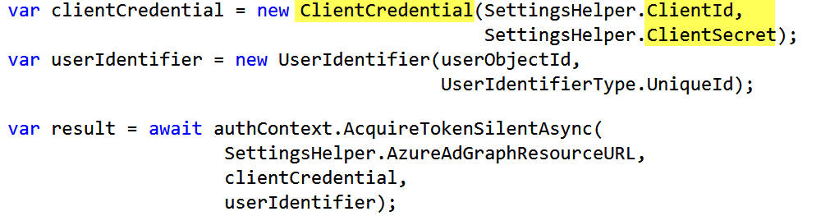
Application authentication
App authentication uses client ID/secret
Protect this information just as you would a user name/password
Notes:
In this snippet from Module 3653-4, notice the Client ID and Client Secret are used to create a credential object.

Slide 25
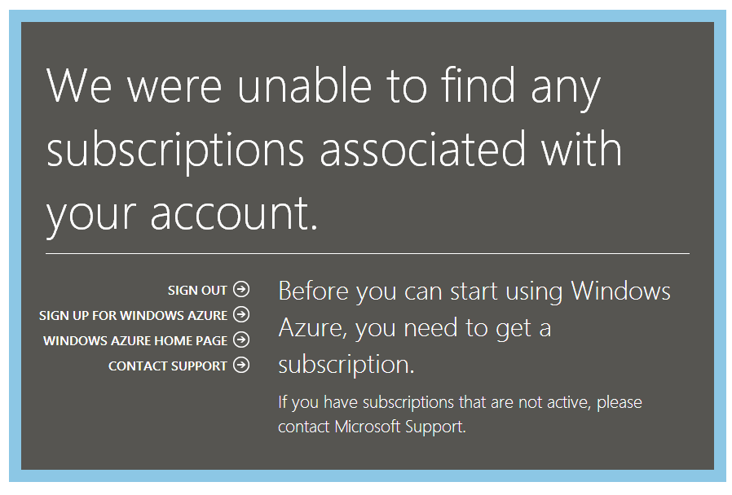
Azure Management Portal (new tenant)

Slide 26
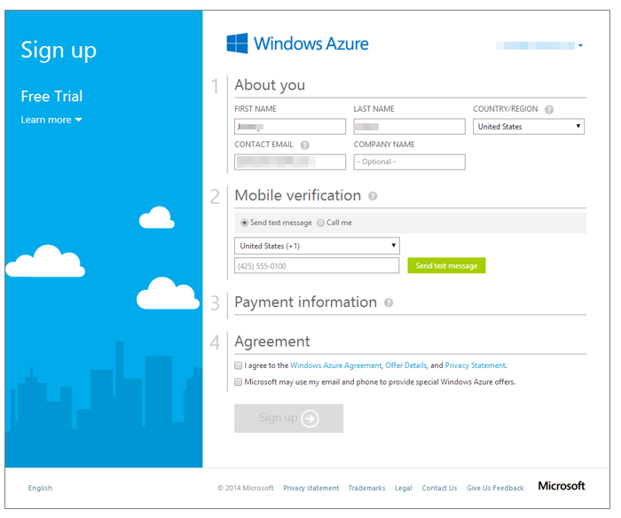
Azure trial sign-up—part 1

Slide 27
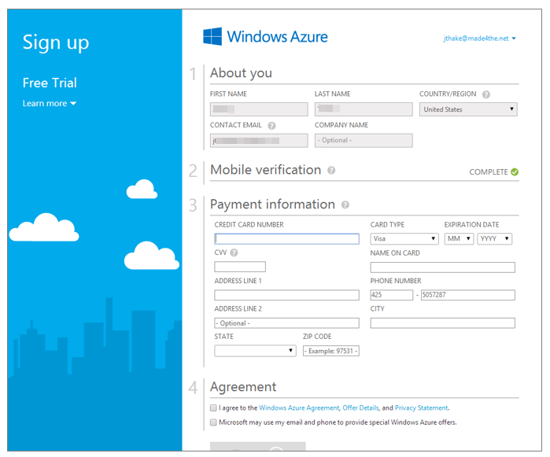
Azure trial sign-up—part 2

Slide 28
5
Troubleshooting

Slide 29
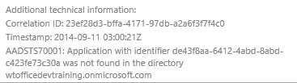
Troubleshooting errors in Auth flow
Login errors
Shown on web page
Fiddler
Shows response/request from apps running on local computer
Review response as JSON
Authentication errors (invalid values)
{"error":"invalid_grant","error_description":"AADSTS70002: Error validating credentials. AADSTS50011: The reply address 'http://localhost:40298/Home/Discovery' is not valid.}

Slide 30
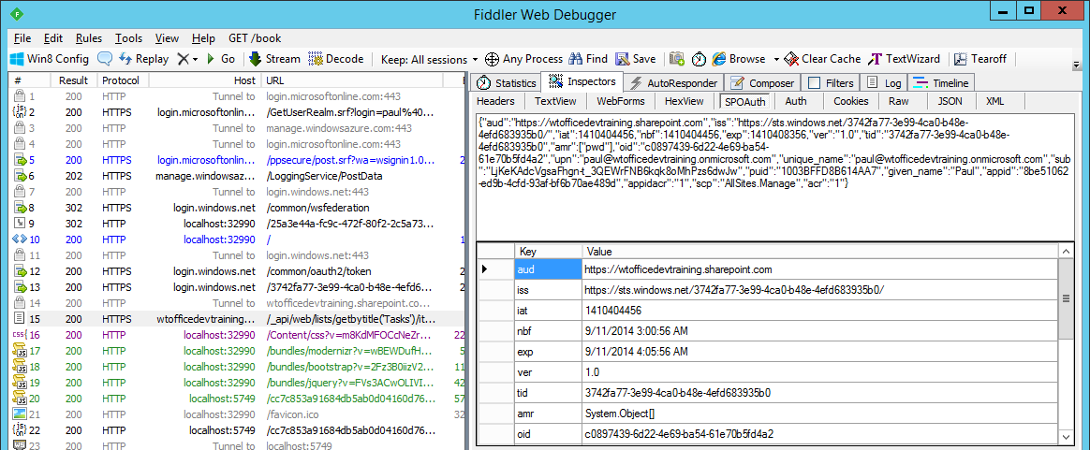
Troubleshooting tokens
Fiddler
Extension to view SharePoint 2013 App tokens
http://blogs.msdn.com/b/kaevans/archive/2013/08/25/creating-a-fiddler-extension-for-sharepoint-2013-app-tokens.aspx
Online
Paste token in web page
http://jwt.io/

Slide 31
Summary
Introduction
OAuth basics and authentication flow
App registration tool
Azure Management Portal access
Troubleshooting

Slide 32
Developer Program launch
1 YEAR FREE
Email Newsletters
Free Developer Subscription
Free Training
Free Tools
Webinars
http://dev.office.com/devprogram

Slide 33
Engage

